Slide 1
Programming Constructs
Ibtisam Mogul

Slide 2
CONTENTS
ITERATION
LOOPS
FOR
WHILE
DO-WHILE

Slide 3
FLOW CONTROL
In a program, statements may be executed
Sequentially
Selectively or
Iteratively.

Slide 4
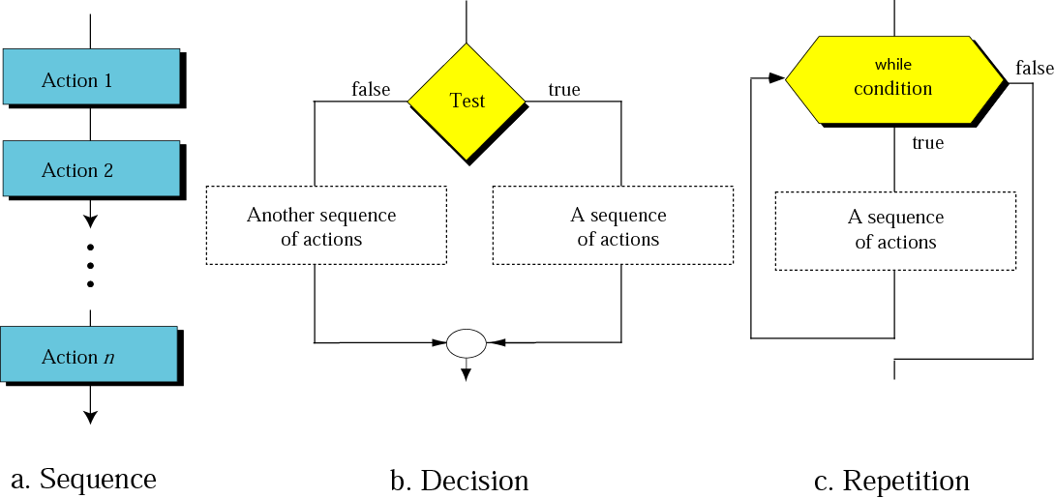
Figure 8-7
Flowcharts for three constructs
Test

Slide 5
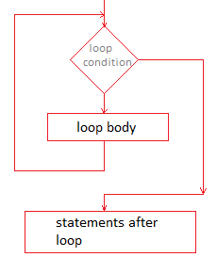
C. ITERATION
false
repetition of set of statements
depending upon a condition test.
A set of statements are repeated again and again.
Till the condition is true.
When condition become false,
the repetition stops.
Also called ”Looping Construct”.
true
Notes:
https://topcoderz.com/kotlin/kotlin-loop/

Slide 6
THE ITERATION CONSTRUCT
Condition ?
False
Statement 3
Loop
True
Statement 1
Statement 2

Slide 7
ITERATION STATEMENT
C# provides three kinds of loops
for
while
do-while

Slide 8
Elements that control a Loop
A loop has four elements:
INITILIZATION EXPRESSIONS
TEST EXPRESSION- Condition
UPDATE EXPRESSION- (incre/ decre) ment
BODY OF THE LOOP

Slide 9
FLowchart of a loop
Initialization of Control variable
condition
(control variable)
true
false
statement
Increment
control variable

Slide 10
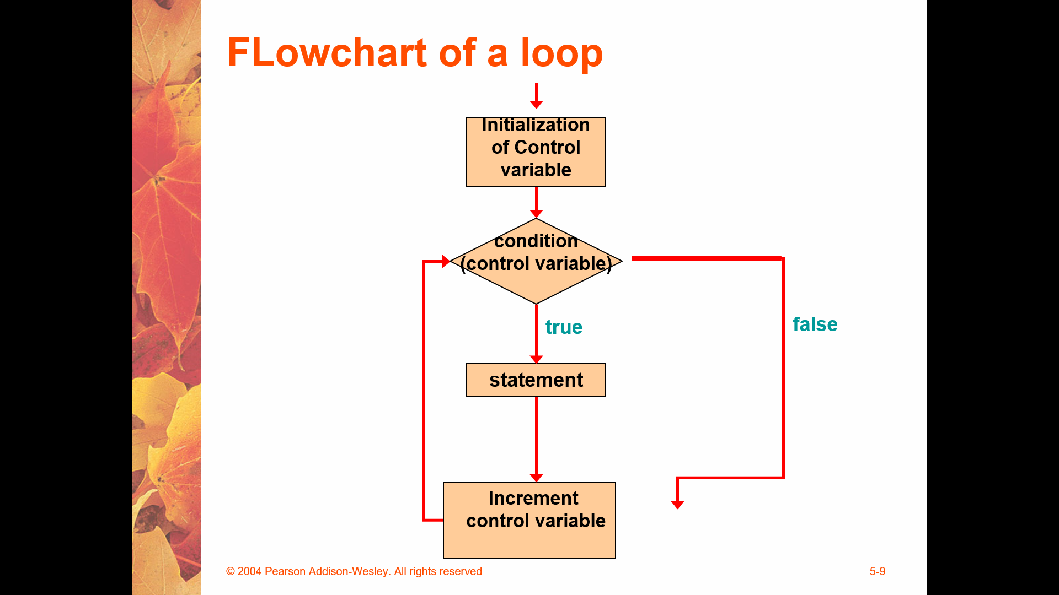
1. INITILIZATION EXPRESSIONS
Before entering in a loop,
its control variable must be initialized.
The initialization expression executes only once.

Slide 11
2. TEST EXPRESSION
Expression whose truth values decides whether the loop- body will be executed or not.
If the test expression/ condition
evaluates to true
the loop body gets executed,
otherwise the loop stops.

Slide 12
3. UPDATE EXPRESSION
The update expression
changes the value of loop variable.
The update expression is executed at the end of the loop
after the loop-body is executed.

Slide 13
4. THE BODY OF THE LOOP
The statements that are
executed repeatedly
as long as the value of expression is true.
If it evaluates to false
then the loop is terminated.

Slide 14
for LOOP
The general form of for loop is,
for(initialization expression; test expression; update expression)
{
body of for loop
}

Slide 15
The for Statement
A for statement has the following syntax:
The initialization
is executed once
before the loop begins
The statement is
executed until the
condition becomes false
for ( initialization ; condition ; increment )
{
statement1;
statement2;
}
The increment portion is executed at the end of each iteration

Slide 16
Logic of a for loop
initialization
condition
evaluated
true
false
statement
increment

Slide 17
Algo- display numbers from 1 to 5
Step 1: Accept number n
Sep 2: Set i to 1
Step 3: if i < =n
Step 4: then Display i
Step 5: Increment i by 1
Step 6: Goto step 3
Endif
Step 7: End
//initialization
//Test Condition with Control Variable
// Body of Loop
//Increment
Loop Back
Out of Loop

Slide 18
i=1,n=5
i<=5?
true
false
Display i
Increment i by 1

Slide 19
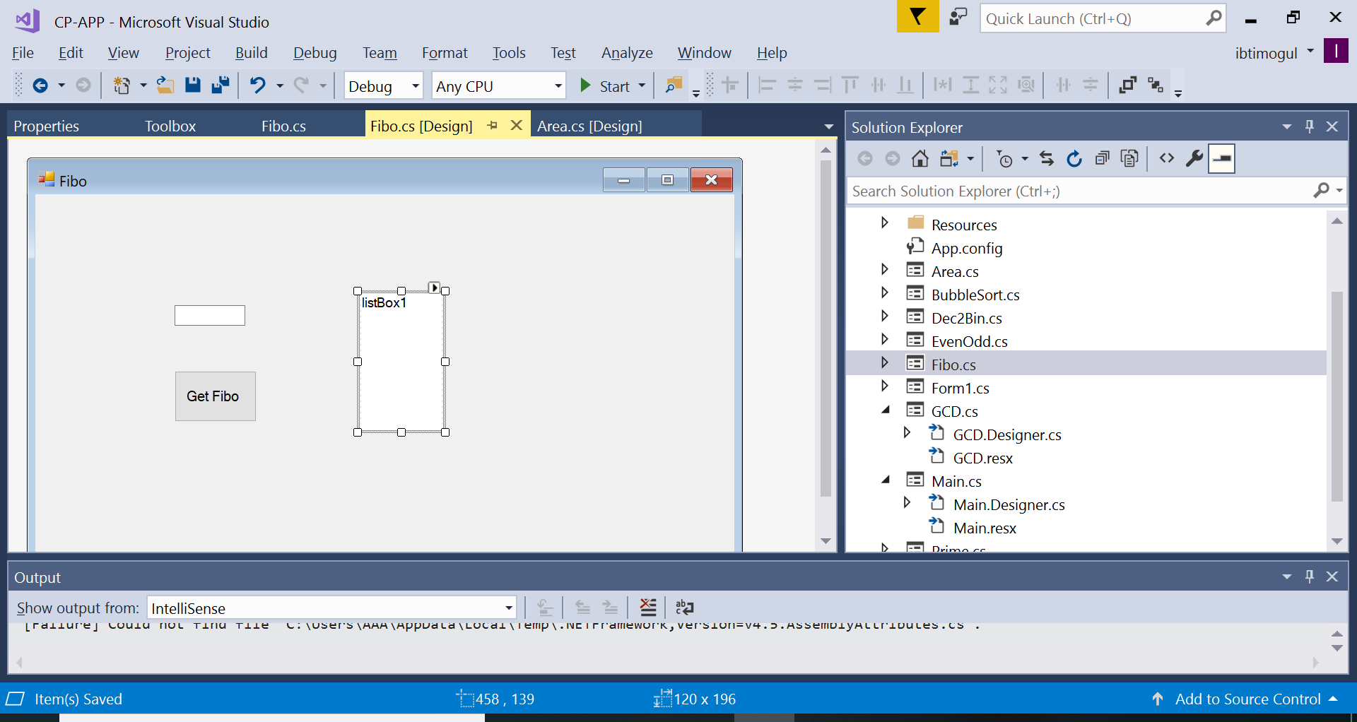

Slide 20
Example :for LOOP
Initilization exp Test Exp Update Exp
for (i = 1 ; i <= n; i++)
{
listBox1.Items.Add(i); //Body of the loop
}

Slide 21
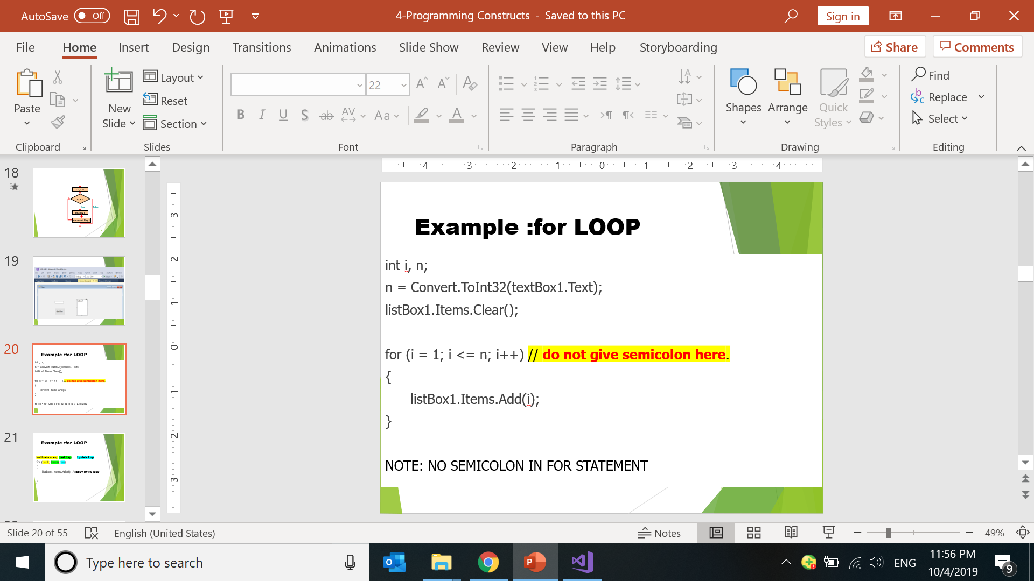

Slide 22
Task
Write a Program to display Fibonacci series of a given Input number
Write Algo and Flowchart for same.

Slide 23
Any Q???

